Slide 1
uCode
UML and Code Generator

Slide 2
Overview
Generate a UML Diagram
Generate code from a UML diagram
Choice of language
Quickly generate stub code
Useful for shortening development time

Slide 3
Supported Features
Inheritance
Aggregation (reference)
Composition
Access Notation
Private
Public
Protected

Slide 4
Patterns and Purposes
Composition
Sharing information between inheritable objects
Factory
Making various types of class objects
Visitor
Getting relevant information from objects
Strategy
Generate code according to language
State
Buttons change GUI
Singleton
Each button and interface should have a single instance
(Bonus) Observer
Update GUI from application logic

Slide 5
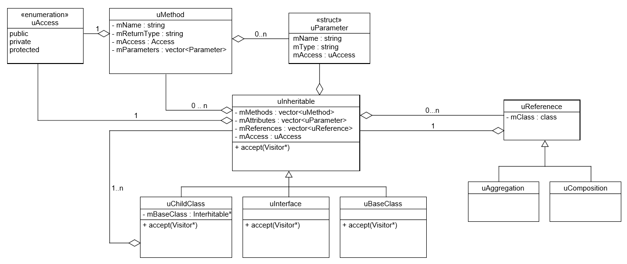
UML - Composite

Slide 6
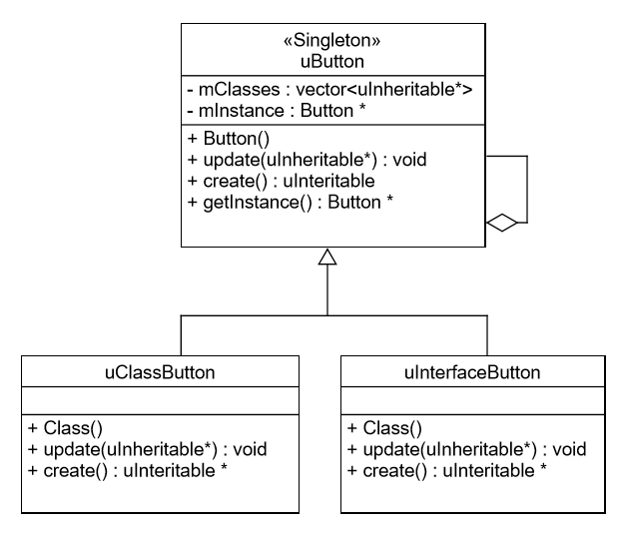
UML – State and Singleton

Slide 7
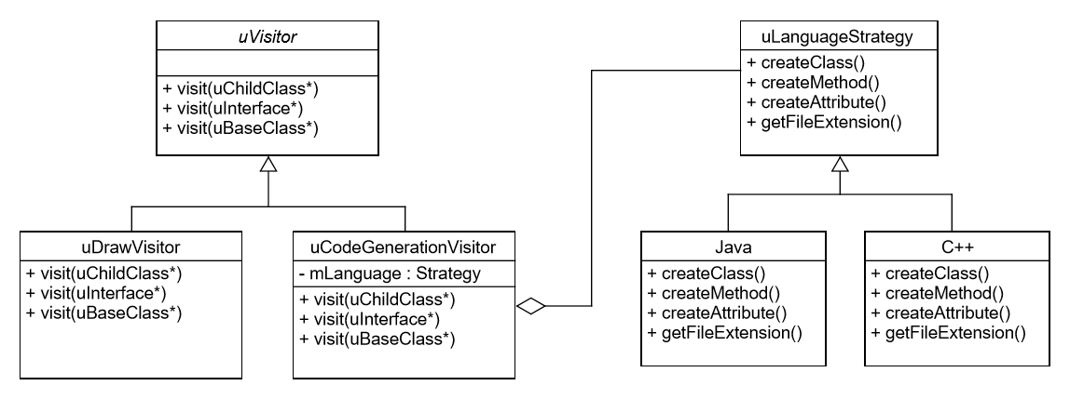
UML – Visitor and Strategy

Slide 8


Slide 9
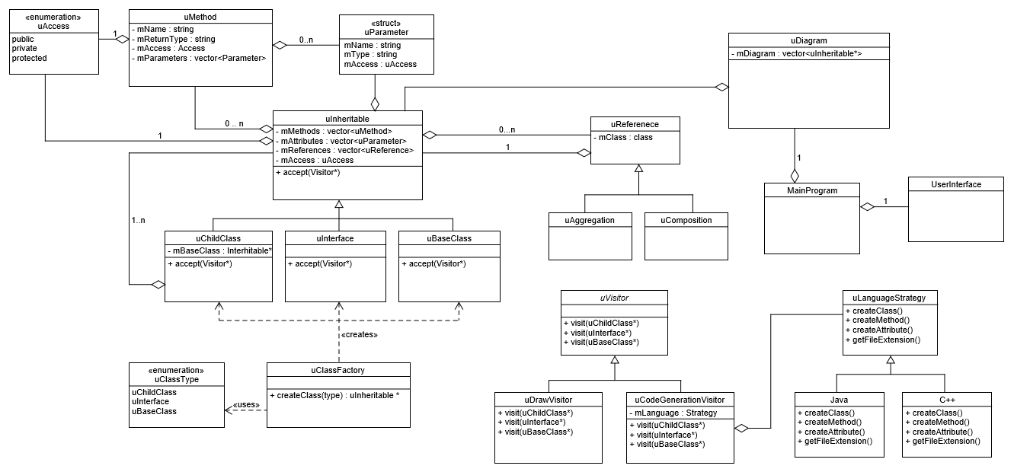
UML - Overview

Slide 10
Functional Requirements
A user should be able to…
Make a new class or interface
Specify a parent class
Add attributes and methods
Click and drag classes
Generate code in a supported language

Slide 11
Non-Functional Requirements
Platform independent
Unit testing with CppUnit
Extendable - Add support for OO languages (Strategy)
Create various objects at run time (Factory)
Control the behavior of the GUI (State)

Slide 12
Use Cases

Slide 13
Environment

